Slide 1
Natural Language Processing
CSCI 5832—Lecture 9
Jim Martin

Slide 2
Today
Moving on to words and what they might mean.
Finish up sparse vectors and PPMI
Move on to dense vectors (embeddings)

Slide 3
But First
Pushing the quiz back a week to Tuesday October 9.
I’ll update the syllabus and the required material on Moodle later today.

Slide 4
Readings
Chapter 2: All
Chapter 3: Skip 3.7
Chapter 4: Skip 4.9 and 4.10
Chapter 5: Skip 5.8
Chapter 6: All
Chapter 7: Skip 7.2
Chapter 8: Skip 8.5, 8.6 and 8.7

Slide 5
tf-idf
tf: term frequency. frequency count (usually log-transformed):
Idf: inverse document frequency: tf-
Total # of docs in collection
Words like "the" or "good" have very low idf
# of docs that have word i
tf-idf value for word t in document d:

Slide 6
Summary: tf-idf
Compare two words using tf-idf cosine to see if they are similar
Comparing two documents
Take the centroid of vectors of all the words in the document
Centroid document vector is:

Slide 7
An Alternative: PPMI
Ask whether a context word is particularly informative about the target word.
Positive Pointwise Mutual Information (PPMI)

Slide 8
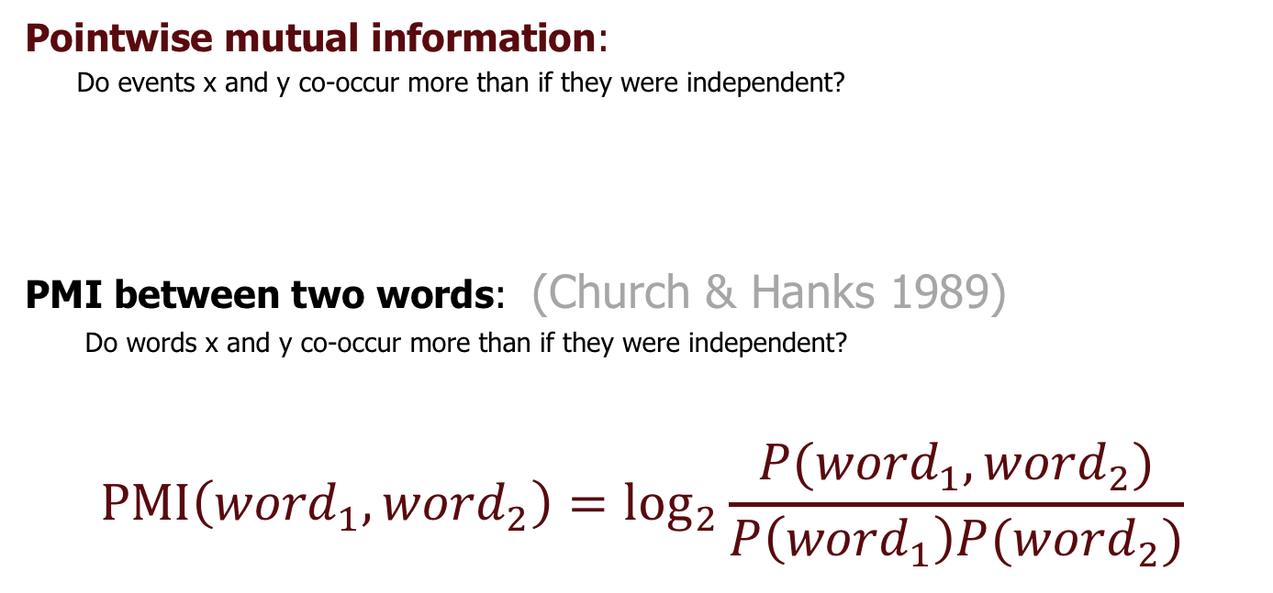
Pointwise Mutual Information
Pointwise mutual information:
Do events x and y co-occur more than if they were independent?
PMI between two words: (Church & Hanks 1989)
Do words x and y co-occur more than if they were independent?
$$\text{PMI}\left({word}_{1}, {word}_{2}\right)={\text{log}}_{2}\frac{P({word}_{1}, {word}_{2})}{P\left({word}_{1}\right)P({word}_{2})}$$

Slide 9
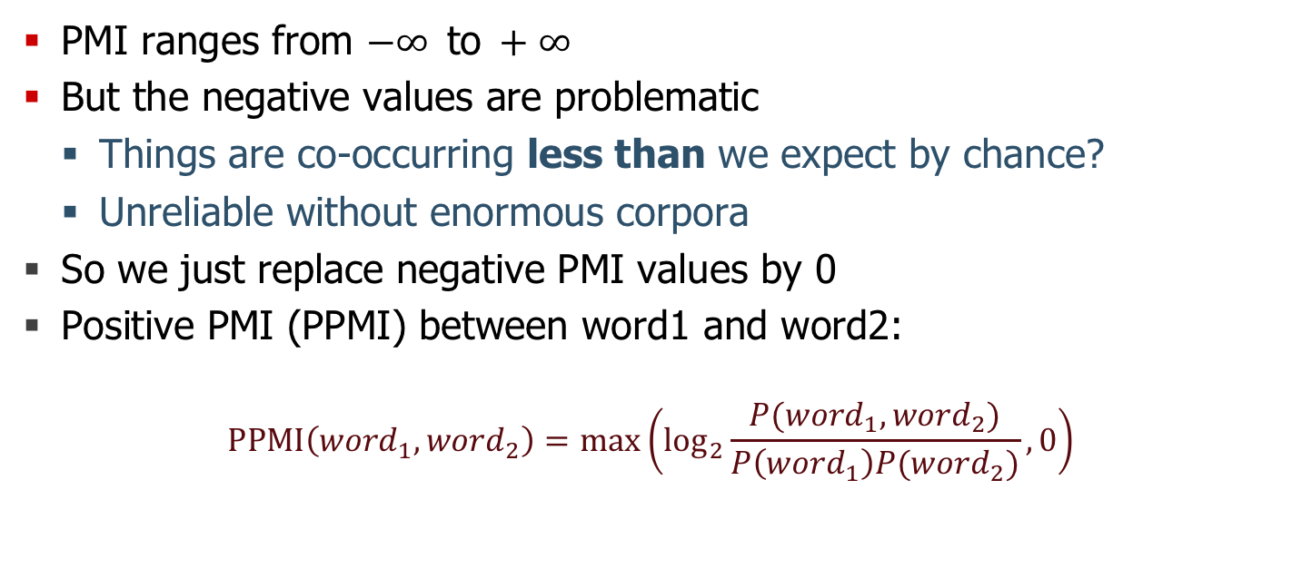
Positive Pointwise Mutual Information
PMI ranges from $−∞ \text{to} +∞$
But the negative values are problematic
Things are co-occurring less than we expect by chance?
Unreliable without enormous corpora
So we just replace negative PMI values by 0
Positive PMI (PPMI) between word1 and word2:
$$\text{PPMI}\left({word}_{1}, {word}_{2}\right)=\max\left({\text{log}}_{2}\frac{P({word}_{1}, {word}_{2})}{P\left({word}_{1}\right)P({word}_{2})},0\right)$$

Slide 10
PPMI on a Term-Context Matrix
Matrix F with W rows (words) and C columns (contexts)
f_{ij} is # of times w_{i} occurs in context c_{j}

Slide 11
PPMI

Slide 12
Tf-idf and PPMI
tf-idf and PPMI vectors are
long (length |V|= 20,000 to 50,000)
sparse (most elements are zero)

Slide 13
Dense Vectors
Vectors which are
Short (length 50-1000)
Often 300
Dense (most elements are non-zero)

Slide 14
Sparse versus dense vectors
Why dense vectors?
Short vectors may be easier to use as features in machine learning (fewer weights to learn)
Dense vectors may generalize better than storing explicit counts
They may do better at capturing synonymy:
car and automobile are synonyms; but are distinct dimensions
a word with car as a neighbor and a word with automobile as a neighbor should be similar, but aren't
In practice, they work better

Slide 15
Word2vec
Popular embedding method
Very fast to train
Code available on the web
Based on prediction rather than counting

Slide 16
Word2vec
Instead of counting how often each word w occurs near "apricot"
Train a classifier on a binary prediction task:
Is w likely to show up near "apricot” ?
Now, we don’t actually care about this task
But we'll take the learned classifier weights as the word embeddings

Slide 17
Key Insight
Use unannotated running text as supervised training data!
A word s near apricot serves as gold ‘correct answer’ to the question
“Is word s likely to show up near apricot ?”
No need for hand-labeled annotation
The idea comes from “neural language modeling”

Slide 18
Review
Binary logistic regression

Slide 19
Logistic Regression Models
Estimate P(c|d) directly w/o Bayes using
Scoring function
Features
Weights
Classification function
Learning

Slide 20
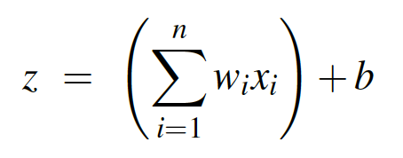
Scoring
We’ll represent documents as sets of features.
With each feature we’ll associate a weight (a real number).
We’ll then assign a score to each document

Slide 21
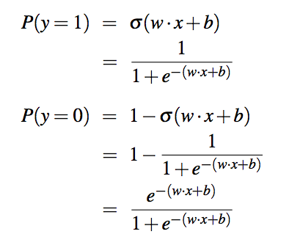
Better Scoring

Slide 22
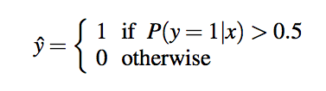
Decision Boundary

Slide 23
Features
The kind of features used in NLP-oriented machine learning systems are
Easily extracted from a text
Are often binary
Think of a feature as being on or off rather than as a feature with a value
E.g. Does this document contain a particular word
Typically have lots and lots of features (100,000s of features isn’t unusual.)

Slide 24
Weights
So where do those weights come from?
We’ll learn the weights making use of a training set and a Loss Function.
Given some labeled training data, a loss function tells us how well we’re doing with the current weights.
The better we do, the lower the loss.

Slide 25
Cross Entropy Loss (1)
Really very simple.
For a given example, we’ll go with the probability assigned to the right answer by the model
In the binary case, the right answer is always either 1 or 0. The model produces a number between 1 and 0, that’s the starting point for the loss.

Slide 26
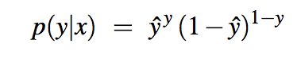
Cross Entropy Loss

Slide 27
Logs
As usual, probabilities aren’t exactly what we want. We want worse performance to have high loss and good performance to have low loss.
So we’ll take the negative of the log of the probability assigned to the correct answer as the loss

Slide 28
Log Prob

Slide 29
Negative Log Prob

Slide 30
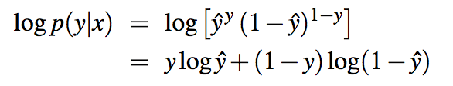
Cross Entropy Loss

Slide 31
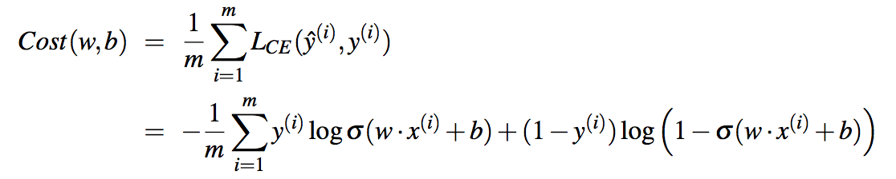
Learning
We want to find the weights and the bias that minimizes this loss across an entire training set.

Slide 32
Learning
We’ll do this by starting with a random set of weights and then iteratively updating those weights to lower this cost.

Slide 33
Word2Vec: Skip-Gram Task
Word2Vec provides a variety of options. Let's do
"skip-gram with negative sampling" (SGNS)

Slide 34
Skip-gram algorithm
Treat the target word and a neighboring context word as positive examples.
Randomly sample other words in the lexicon to get negative samples
Use logistic regression to train a classifier to distinguish those two cases
Use the weights as the embeddings

Slide 35
Skip-Gram Objective
Given a tuple (t,c) = target word, context word
(apricot, jam)
(apricot, aardvark)
Return the probability that c is a real context word:
P(+|t,c)
P(−|t,c) = 1−P(+|t,c)

Slide 36
How to Compute p(+|t,c)?
Intuition
Words are likely to appear near similar words
Model similarity with dot-product!
Similarity(t,c) ∝ t ∙ c
Problem:
Dot product is not a probability!

Slide 37
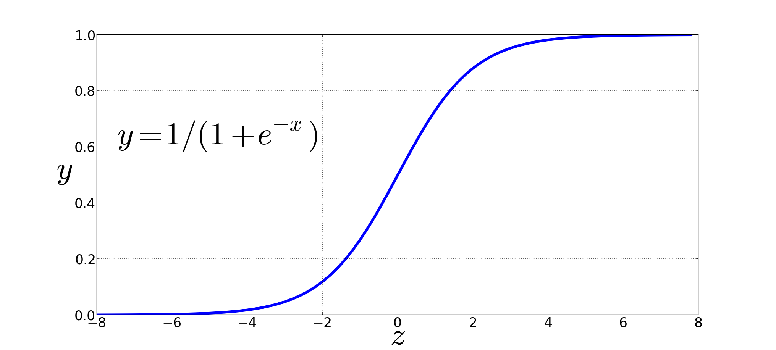
Dot product into a probability
The sigmoid lies between 0 and 1:

Slide 38
Dot product into a probability

Slide 39
For all the words in a context
Assume all the context words are independent

Slide 40
Skip-Gram Training Data
Training sentence:
... lemon, a tablespoon of apricot jam a pinch ...
c1 c2 t c3 c4
Training data: input/output pairs centering on apricot
Asssume a +/- 2 word window

Slide 41
Skip-Gram Training
Training sentence:
... lemon, a tablespoon of apricot jam a pinch ...
c1 c2 t c3 c4
For each positive example, we'll create k pseudo-negative examples.
Using noise words
Any random word that isn't t

Slide 42
Skip-Gram Training
Training sentence:
... lemon, a tablespoon of apricot jam a pinch ...
c1 c2 t c3 c4
k=2

Slide 43
Choosing Noise Words
Could pick w according to their unigram frequency P(w)
More common to chosen then according to p_{α}(w)
α= ¾ works well because it gives rare noise words slightly higher probability

Slide 44
Setup
Let's represent words as vectors of some length (say 300), randomly initialized.
So we start with 300 * V random parameters
Over the entire training set, we’d like to adjust those word vectors such that we
Maximize the similarity of the target word, context word pairs (t,c) drawn from the positive data
Minimize the similarity of the (t,c) pairs drawn from the negative data.

Slide 45
Learning
Iterative process.
We’ll start with random weights
Then adjust the word weights to
make the positive pairs more likely
More similar
and the negative pairs less likely
Less similar
over the entire training set

Slide 47
Objective Criteria
We want to maximize…
Maximize the + label for the pairs from the positive training data, and the – label for the pairs sample from the negative data.

Slide 48
Train using gradient descent
Actually learns two separate embedding matrices W and C
Can use W and throw away C, or merge them somehow

Slide 49
Skip-Gram Summary
Start with V random 300-dimensional vectors as initial embeddings
Use logistic regression, the second most basic classifier used in machine learning after naïve bayes
Take a corpus and take pairs of words that co-occur as positive examples
Take pairs of words that don't co-occur as negative examples
Train the classifier to distinguish these by slowly adjusting all the embeddings to improve the classifier performance
Throw away the classifier and keep the embeddings.

Slide 50
Dense Embeddings Without the Work
Word2vec (Mikolov et al.) https://code.google.com/archive/p/word2vec/
Fasttext http://www.fasttext.cc/
Glove (Pennington, Socher, Manning) http://nlp.stanford.edu/projects/glove/

Slide 51
Evaluating Embeddings
Compare to human scores on word similarity-type tasks
WordSim-353 (Finkelstein et al., 2002)
SimLex-999 (Hill et al., 2015)
Stanford Contextual Word Similarity (SCWS) dataset (Huang et al., 2012)
TOEFL dataset: Levied is closest in meaning to: imposed, believed, requested, correlated

Slide 52
Evaluating Embeddings
Compare to human scores on word similarity-type tasks
WordSim-353 (Finkelstein et al., 2002)
SimLex-999 (Hill et al., 2015)
Stanford Contextual Word Similarity (SCWS) dataset (Huang et al., 2012)
TOEFL dataset: Levied is closest in meaning to: imposed, believed, requested, correlated

Slide 53
Properties of embeddings
Similarity depends on window size C
C = ±2 The nearest words to Hogwarts:
Sunnydale
Evernight
C = ±5 The nearest words to Hogwarts:
Dumbledore
Malfoy
halfblood

Slide 54
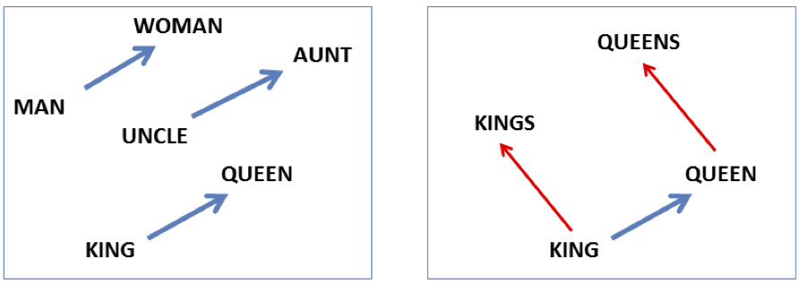
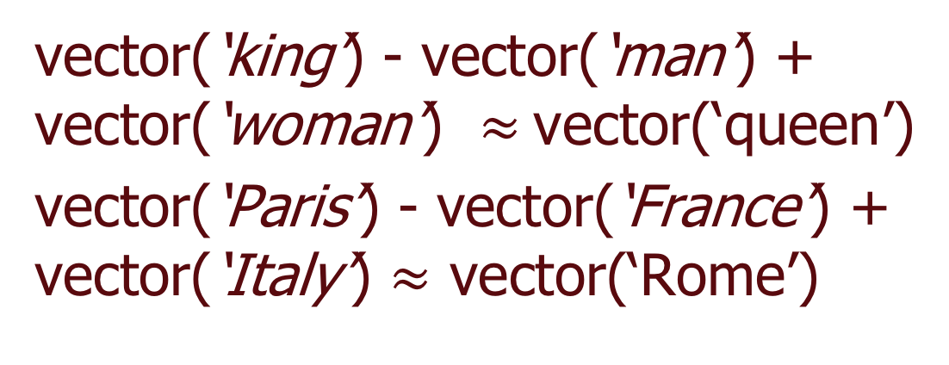
Analogy
vector(‘king’) - vector(‘man’) + vector(‘woman’) $≈$vector(‘queen’)
vector(‘Paris’) - vector(‘France’) + vector(‘Italy’) $≈$ vector(‘Rome’)

Slide 55
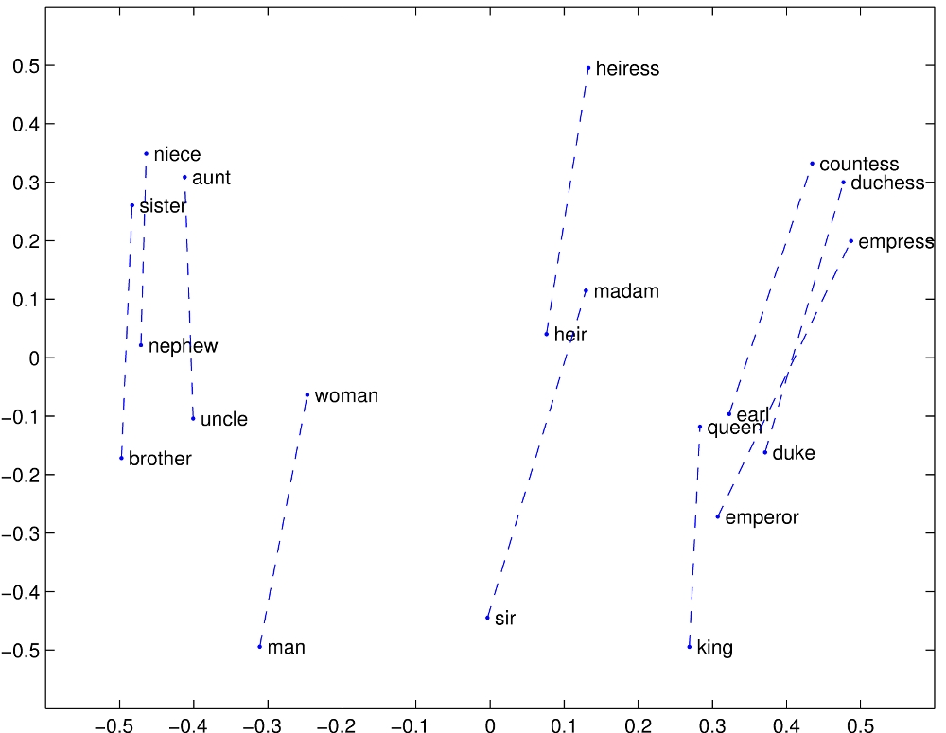

Slide 56
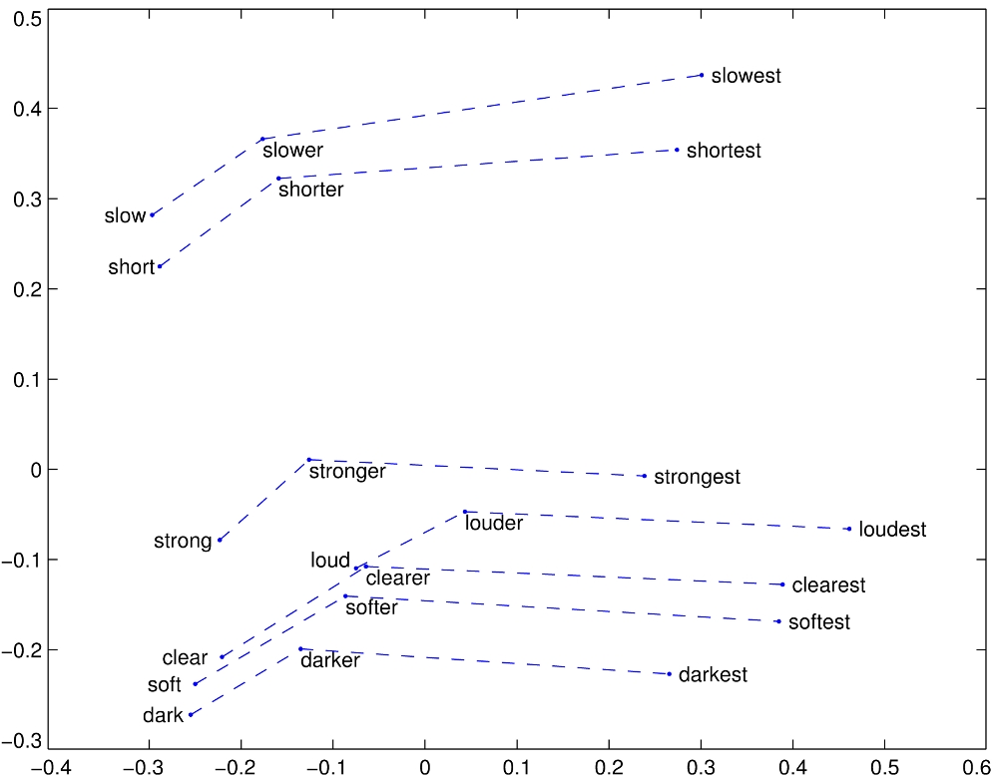

Slide 57
Diachronics Study of Language Change
Train embeddings on older texts to study changes in word meaning!!
For a given word, look at how its neighbors change over time.

Slide 58




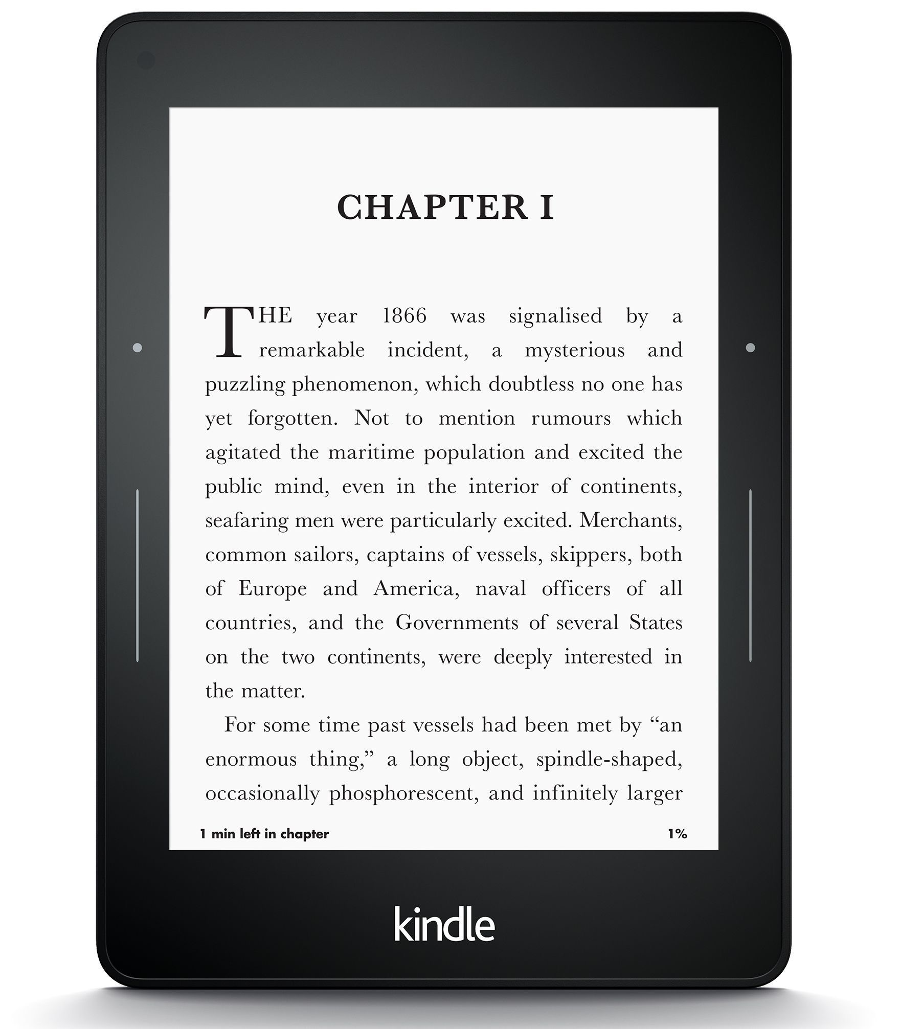
Diachronics Study of Language Change
Word vectors for 1920
Word vectors 1990
“dog” 1990 word vector
“dog” 1920 word vector
vs.
1900
1950
2000
￼
￼

Slide 59
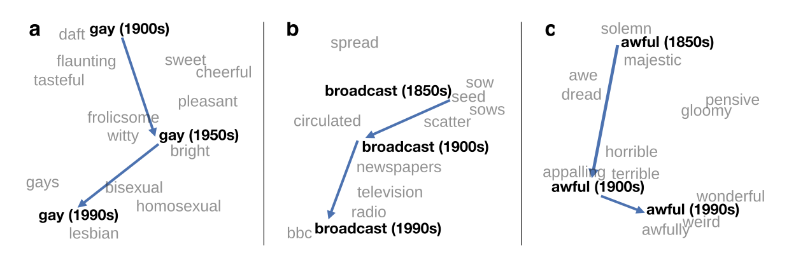
Visualizing changes
Project 300 dimensions down into 2
~30 million books, 1850-1990, Google Books data

Slide 60
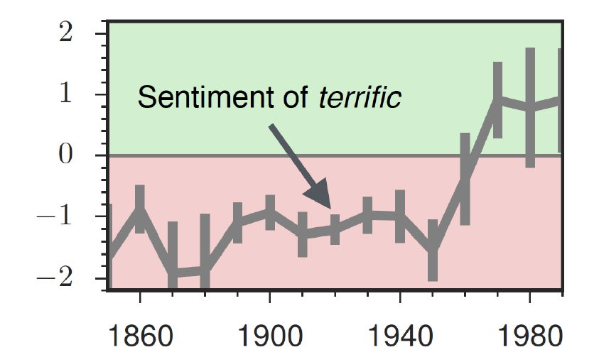
Evolution of Sentiment Words

Slide 61
Embeddings Reflect Cultural Biases
Ask “Paris : France :: Tokyo : x”
x = Japan
Ask “father : doctor :: mother : x”
x = nurse
Ask “man : computer programmer :: woman : x”
x = homemaker

Slide 62
Embeddings Reflect Cultural Biases
Princeton trilogy experiments
Attitudes toward ethnic groups (1933, 1951, 1969) scores for adjectives
Industrious, superstitious, nationalistic, etc.
Cosine of Chinese name embeddings with those adjective embeddings correlates with human ratings.

Slide 63
Change over time 1910-1990
Change in association of Chinese names with adjectives framed as "othering" (barbaric, monstrous, bizarre)

Slide 64
Changes in framing: adjectives associated with Chinese

Slide 65
Conclusion
Concepts or word senses
Have a complex many-to-many association with words (homonymy, multiple senses)
Have relations with each other
Synonymy, Antonymy, Superordinate
But are hard to define formally (necessary & sufficient conditions)
Embeddings = vector models of meaning
More fine-grained than just a string or index
Especially good at modeling similarity/analogy
Just download them and use cosines!!
Can use sparse models (tf-idf) or dense models (word2vec, GLoVE)
Useful in practice but know they encode cultural stereotypes

